Slide 1


Introduction to Data Analytics
Notes:
Welcome to the first module of the course. In this module, we will overview the definition of data analytics and will briefly examine the history of the field. We will also discuss some of the key drivers behind the recent advancements in the field of data analytics. Later on we discuss the differences between business intelligence and predictive modelling. After that various cognitive biases that can affect our ability as humans to make rational decisions are introduced and we discuss how data driven approaches can minimize the effects of such biases and heuristics in our decisions. Finally, various steps of analytics projects are introduced and discussed.

Slide 2
What is Data Analytics? Few Definitions.
Data analytics refers to qualitative and quantitative techniques and processes used to enhance productivity and business gain using data.
Data analytics is the pursuit of extracting meaning from raw data using specialized computer systems. These systems transform, organize, and model the data to draw conclusions and identify patterns.
Data analytics is an examination of data made to gain a better understanding of the data itself and the organization that produced it.
Notes:
So what is data analytics? Well, there has been a number of definitions for the data analytics in the literature. In fact, according to one definition, data analytics refers to a set of qualitative and quantitative methods that are used to improve business productivity by using data. A similar, definition describes data analytics as the process of analyzing the data to understand the data and more importantly the organization that produces the data. What is common among these definitions, is the fact that in data analytics procedures the idea is to leverage data for extracting some useful insights. As you can see, these definitions are very broad and extensive so as the scope of data analytics.

Slide 3
History of Data Analytics
Notes:
So let us have a look at the history of data analytics. The field of data analytics is closely related to statistics which itself can be described as the practice of collecting and analyzing data with the objective of extracting insights from the data. Ronald Fisher, without any doubts, is envisioned as the father of many of the existing modern statistical methods. One of his notable contributions was to formally introduce the concept of "design of experiments" in 1935. Design of experiments refers to a set of steps and guidelines for planning, conducting and analyzing data. Four years later, the "quality control" framework was introduced by Edward Deming who was a leading management thinker in the field of quality. Subsequently, the term "Business Intelligence Systems" was coined by Peter Luhn in 1958 who at the time was as a computer science researcher working for IBM. He described the business intelligence as a set of automated subsystems that can be deployed to analyze the data to create “action points” in the organizations. Subsequently, in 1977, the concept of exploratory data analysis was introduced by John Tukey. Exploratory data analysis deals with analyzing data sets to summarize their main characteristics and often involves visualization methods as well. The modern business intelligence as we know today has been significantly influenced by efforts of Howard Dresner who described business intelligence as an umbrella term which refers to "concepts and methods to improve business decision making by using fact-based support systems.". Finally, the field of machine earning emerged where computer algorithms are used to find robust patterns in the data that can be generalized. Tom Mitchel, the author of the textbook "Machine Learning" is known for his significant contributions to the field of machine learning.

Slide 4
History of Data Analytics
The field of analytics has recently evolved significantly, owing to the following key reasons:
Reduced Cost of Computing
Reduced Cost of Data Storage
Emergence of New Algorithms
Performance Improvement of Algorithms
Notes:
The field of analytics has recently witnessed some significant changes. So let us examine some of the key drivers of such changes. At a high level, we can identify four main reasons contributing to the advancement of the field. This includes the reduced cost of computing, the reduced cost of data storage, the emergence of new algorithms and finally the improved performance of algorithms. We will discuss these points one by one in more details in the following slides.

Slide 5
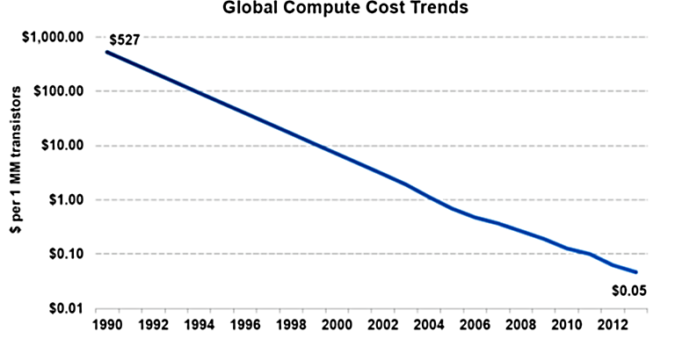
Computing Cost
Notes:
Let us start with a computing and hardware cost as one of the primary reasons that made analyzing large quantities of data to become feasible. As shown in the graph, the cost of 1 million units of transistors has been significantly reduced from the early 90's to 2012, and the trend continues. A transistor is the most elementary building block of a computer system and therefore can be used to reflect the cost of the overall system. For example, the cost of 1 million transistors was around $527 in the early 90's while it is reduced to about 5 dollar cents in 2012. This dramatic drop in computing cost has made it economical for the organizations to deploy computer systems at a large scale to analyze the data to gain valuable insights from the data.

Slide 6
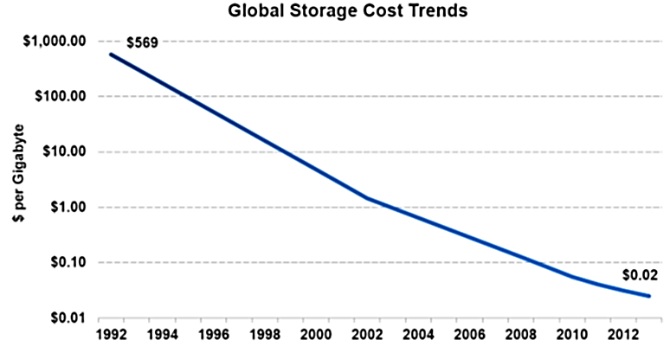

Storage Cost
Notes:
Similarly, the cost of data storage is another important consideration. In order to analyze the data, the data needs to be captured and stored. From the chart, it is apparent that the cost of storage has been declining continuously from early 90's to 2012 and again the trend is continuing. Just as an example, storing 1 GB of data would have cost more than 500$ during the 90's whereas it is reduced to less than 2 dollar cents nowadays. Evidently, Organizations have more incentives to deploy data analytics solutions when the cost of data storage is low.

Slide 7
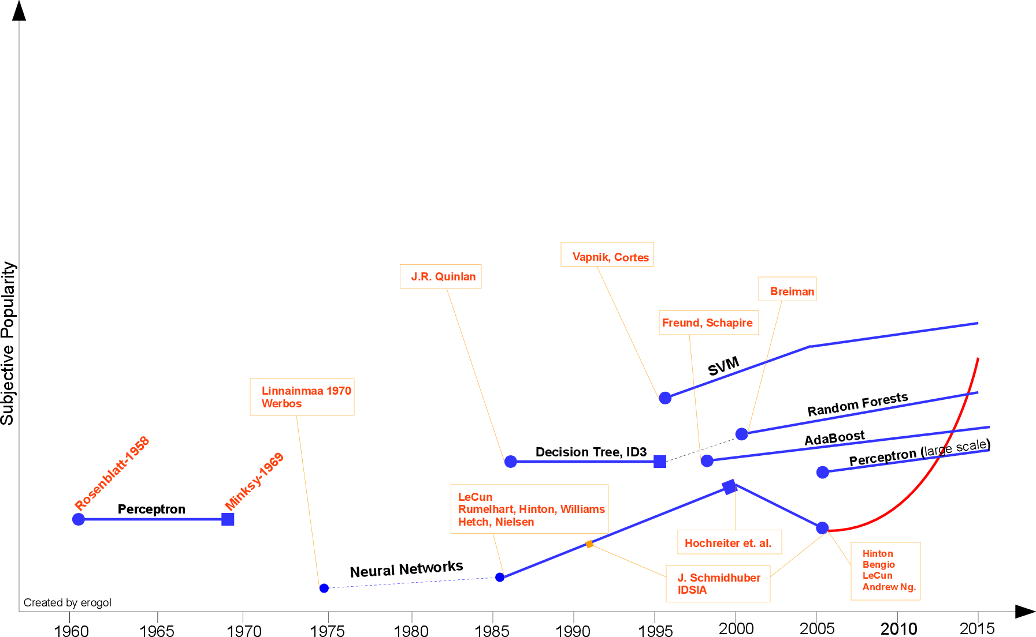
Emergence of New Algorithms
Notes:
Another important factor that has resulted in the advancement of data analytics systems is the emergence of new algorithms. The following figure shows the subjective popularity of machine learning and data mining algorithms starting from the 1960's up to recent years. As the graph shows, the perceptron algorithm was introduced during the early 60s and have been evolved into neural networks in 1975. You can also see the emergence of other algorithms such as decision trees, support vector machines, and boosting algorithms during the more recent years. Also, there have been some significant developments in neural networks sine 2005 when the concept of deep neural networks was introduced. Deep neural networks are special types of neural networks which consist of a large number of layers and are generally computationally intensive but can outperform other algorithms in many applications.

Slide 8
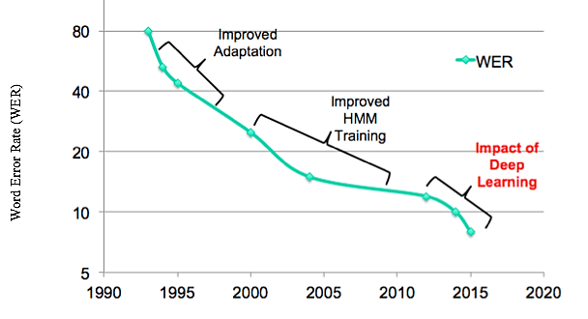
Example: Word Error Rate in Automatic Speech Recognition (ASR)
Improvements in Algorithms’ Performance
Notes:
All of the previous factors have resulted in some notable improvements in the performance of machine learning and data mining algorithms. This slide shows an example of the improved accuracy of speech recognition algorithms over the years. The idea of speech recognition systems is to use machine learning models to understand words spoken by a human. Applications of speech recognition systems include voice user interfaces such as voice dialing in Siri or smart appliance controls systems in Google Home or Amazon Alexa Systems. In this graph, the Y-axis represents the average percentage of the words that are misunderstood by the algorithms. As you can see, the error rate was as high as 80% during the early 90's implying that out of 100 words 80 words were misunderstood which made the system completely useless. This error rate has been improved over the years an is now well below 10%. These improvements are because of several factors that we discussed including more computing power, the availability of training data, as well as more efficient algorithms such as deep learning models.

Slide 9
Quiz
Which of the followings is not a contributing factor for advancement of the field of data analytics?
Increased computing power at lower cost
Emergence of more efficient algorithms
Reduced cost of database systems for storing data
Availability of expert data analysts in organizations
(Correct answer is D)

